Slide 1
Digital Image Processing Technologies & Applications
Image Restoration

Slide 2
Contents
In this lecture we will look at image restoration techniques used for noise removal
What is image restoration?
Noise models
Noise removal using frequency domain filtering
Estimating the degradation function
Inverse filtering
Weiner Filtering

Slide 3
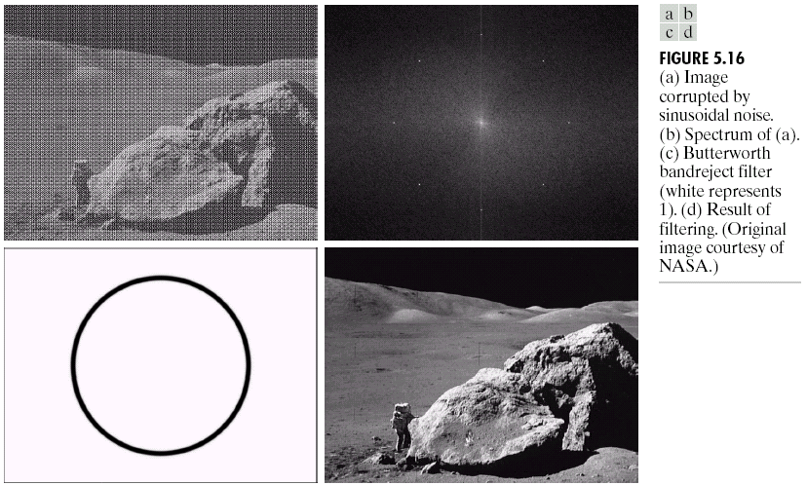
What is Image Restoration?
Image restoration attempts to restore images that have been degraded
Identify the degradation process and attempt to reverse it
Similar to image enhancement, but more objective

Slide 4
Enhancement vs. Restoration
Enhancement Restoration
“Better” visual representation
Subjective
No quantitative measures
Mathematical
Model dependent
Objective
Quantitative measures

Slide 5
Image Restoration General
One has to have some a priori knowledge about the degragation process.
Usually we need to know:
The noise in the original image
Model for degragation
Some information from original image

Slide 6
A Model of Image Degradation and Restoration
The degradation process is modeled as a degradation function that together with an additive noise term.
In frequency domain representation:
Where: f(x,y) is the input image, g(x,y) is the degraded image, h(x,y) is the degradation function, and is the additive noise.
Notes:
η：依塔 Eta

Slide 7
Degradation Model
f(x,y)
h(x,y)
Σ
g(x,y)
n(x,y)
Degradation Model: g = h*f + n

Slide 8
Restoration Model
Degradation
Model
g(x,y)
Restoration
Filter
f(x,y)
f(x,y)
Unconstrained Constrained
Inverse Filter
Pseudo-inverse Filter
Wiener Filter

Slide 9
Restoration Model
The objective of restoration is to obtain an estimate of the original image f(x,y).
Generally, the more we know about H, and , the will be closer to f(x,y).
The approach used throughout most of this chapter is based on various types of image restoration filters.

Slide 10
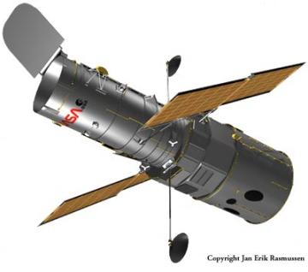
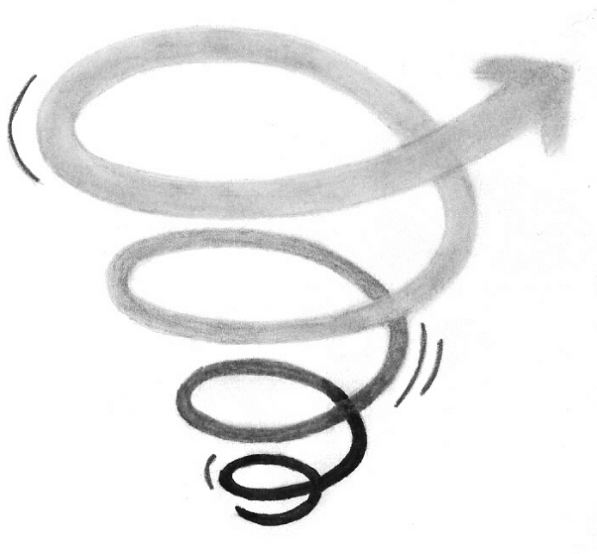
Noise and Images
The sources of noise in digital images arise during image acquisition (digitization) and transmission
Imaging sensors can be affected by ambient conditions
Interference can be added to an image during transmission

Slide 11
Noise Models
There are many different models for the image noise term η(x, y):
Gaussian
Most common model
Rayleigh
Erlang (Gamma)
Exponential
Uniform
Impulse
Salt and pepper noise

Slide 12
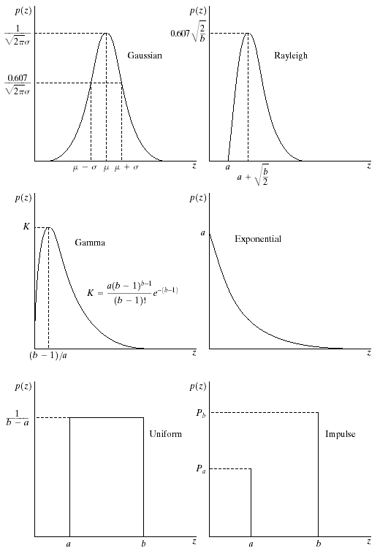
Noise Models
Gaussian noise:
Rayleigh noise:

Slide 13
Noise Models
Erlang (Gamma) noise:
Exponential noise:

Slide 14
Noise Models
Uniform noise:
Impulse noise:

Slide 15
Noise Models
Impulse noise is also called salt-and-pepper noise.
For p_{a}=p_{b}=0.05
128 128 128 128 128 128 128 128 128 128
128 128 128 128 128 128 128 128 128 128
128 128 128 128 128 128 128 128 128 128
128 128 128 128 128 128 128 128 128 128
128 128 128 128 128 128 128 128 128 128
128 128 128 128 128 128 128 128 128 128
128 128 128 128 128 128 128 128 128 128
128 128 128 128 128 128 128 128 128 128
128 128 128 128 128 128 128 128 128 128
128 128 128 128 128 128 128 128 128 128
128 128 255 0 128 128 128 128 128 128
128 128 128 128 0 128 128 128 128 0
128 128 128 128 128 128 128 128 128 128
128 128 0 128 128 128 128 128 128 128
128 128 128 255 128 128 128 128 128 128
128 128 128 128 128 128 128 128 128 128
128 128 128 128 128 128 128 128 128 128
0 128 128 128 128 255 128 128 128 128
128 128 128 128 128 128 128 128 128 255
128 128 128 128 128 128 128 255 128 128
Input image
Degraded image
Noise level p=0.05 means that approximately 5% of pixels are contaminated by salt or pepper noise (highlighted by red color)

Slide 16
MATLAB Command
>Y = IMNOISE(X,'salt & pepper',p)
Notes:
Example: impulsenoise.m
The intensity of input images is assumed to be normalized to [0,1]. If X is not double, you need to do normalization first, i.e., X=X/255; If X is uint8, MATLAB would do the normalization automatically.
The default value of p is 0.05 (i.e., 5 percent of pixels are contaminated).
Imnoise function can produce other types of noise as well (you need to change the noise type ‘salt & pepper’).

Slide 17
Noise Models
Remarks:
The preceding PDFs provide useful tools for modeling a broad range of noise corruption situations in practice.
Gaussian noise arises due to factors such as electronic circuit noise, and sensor noise caused by poor illumination and/or high temperature.
Rayleigh is helpful in characterizing noise phenomena in range imaging.
Exponential and gamma find application in laser imaging.
Impulse noise is found in situations where quick transients, such as faulty switching.
Uniform is the least descriptive of practical situations. However, it is quite useful in simulations.

Slide 18
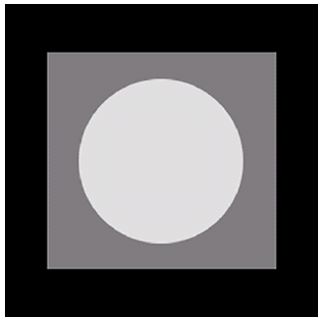
Noise Example
The test pattern to the right is ideal for demonstrating the addition of noise.
The following slides will show the result of adding noise based on various models to this image.
Image
Histogram to go here
Histogram

Slide 19
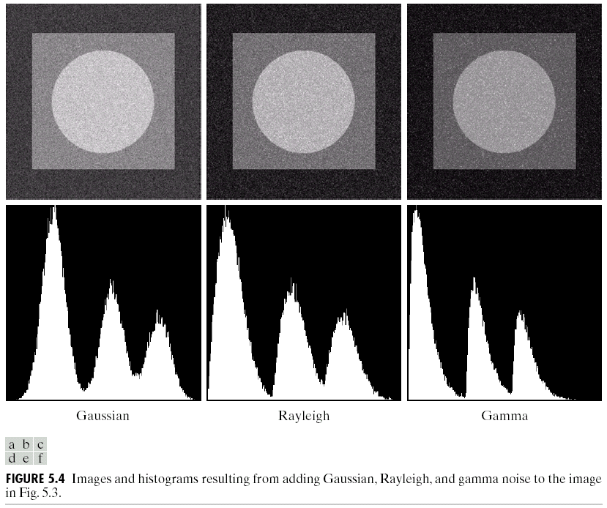
Noise Example (cont…)
Gaussian
Rayleigh
Erlang

Slide 20
Noise Example (cont…)
Exponential
Uniform
Impulse

Slide 21
Periodic Noise
Periodic noise in an image arises typically from electrical or electromechanical interference during image acquisition.
Characteristics
Spatially dependent
Periodic – easy to observe in frequency domain
Processing method
Suppressing noise component in frequency domain
Notes:
electromechanical 机电的

Slide 22
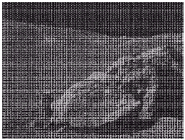
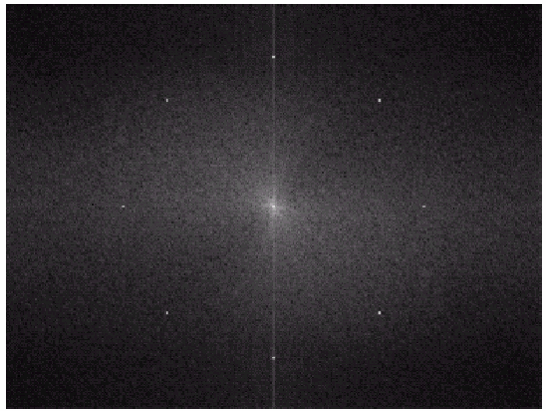
Periodic Noise
Reference to Table 4-1:
spatial
Frequency (note the four pairs of bright dots)

Slide 23
Estimation of Noise Parameters
Periodic noise typically are estimated by inspection of the Fourier spectrum of the image.
The parameters of noise PDFs may be known from sensor specifications.
Sometimes, it is necessary to estimate them for a particular imaging device.
When images generated by the sensor are available, frequently it is possible to estimate the parameters of the PDF from small patches of constant gray level.

Slide 24
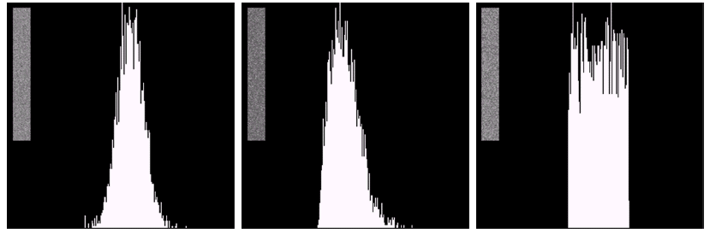
Estimation of Noise Parameters
Gaussian noise Rayleigh noise Uniform noise

Slide 25
Estimation of Noise Parameters
The simplest way to use the data from the image strip is for calculating the mean and variance of the gray levels.
Where z_{i} is the gray level values of the pixels in S, and p(z_{i}) are the corresponding normalized histogram values.

Slide 26
Estimation of Noise Parameters
If the shape is approximately Gaussian, then the mean and variance is all we need. Because Gaussian PDF is completely specified by these two parameters.

Slide 27
Estimation of Noise Parameters
For the other shapes discussed before, we can use the mean and variance to calculate the parameters a and b. For example, Rayleigh noise:
For impulse noise we can estimate the probability of occurrence of white and black pixels. So, a midgray, relatively constant area is needed.

Slide 28
Restoration of Noise Only Degradation
We can consider a noisy image to be modelled as follows:
where f(x, y) is the original image pixel, η(x, y) is the noise term and g(x, y) is the resulting noisy pixel.

Slide 29
Restoration of Noise Only Degradation
If the noise is known, we can just subtract them from g(x,y) or G(u,v) to restore f(x,y) or F(u,v).
In the case of periodic noise, it is possible to estimate N(u,v) from the spectrum of G(u,v), then N(u,v) can be subtracted from G(u,v) to obtain an estimate of the original image.
Usually, the noise is unknown, so subtracting them from g(x,y) or G(u,v) is not a realistic option.
When only additive noise is present, spatial filtering is a choice. In this case, enhancement and restoration become almost the same.

Slide 30
Periodic Noise Reduction by Frequency Domain Filter
Here we will look at more specialized frequency domain filters, which are efficient to reduce or remove periodic noise. They are:
Bandreject filter
Bandpass filter
Notch filter

Slide 31
Periodic Noise
spatial
Frequency (note the four pairs of bright dots)
Removing periodic noise form an image involves removing a particular range of frequencies from that image.
Band reject filters can be used for this purpose.

Slide 32
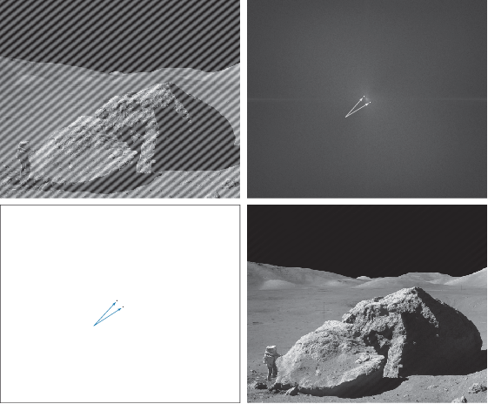
Periodic Noise

Slide 33
Band Reject Filters
An ideal band reject filter is given as follows:
W is the band width, D₀ is its ring center.

Slide 34
Band Reject Filters
Butterworth bandreject filter of order n:
Gaussian bandreject filter:

Slide 35
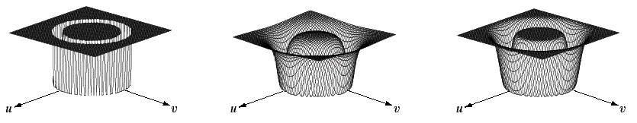
Band Reject Filters (cont…)
The ideal band reject filter is shown below, along with Butterworth and Gaussian versions of the filter
Ideal Band Reject Filter
Butterworth Band Reject Filter (of order 1)
Gaussian Band Reject Filter

Slide 36
Band Reject Filter Example
Image corrupted by sinusoidal noise
Fourier spectrum of corrupted image
As sharp and narrow as possible
Butterworth band reject filter
Filtered image

Slide 37
Band Pass Filter
Opposite operation of a bandreject filter
Can be obtained from a corresponding bandreject filter with transfer function H_{br}(u,v)

Slide 38

Band Pass Filter Example
Bandpass filter helped isolate the noise pattern.
This is a useful result because it simplifies analysis of the noise, reasonable independently of image content.

Slide 39
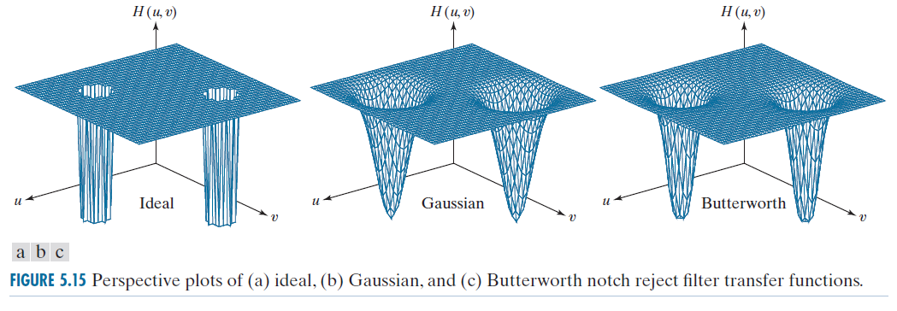
Notch Filter
Reject (or pass) frequencies in predefined neighborhoods about a center frequency:
Notch reject filter, and Notch pass filter.
Notch reject filter:
Notes:
陷波滤波器

Slide 40
Notch Filter
Symmetry:
In symmetric pairs about the origin
Exception: Origin
The number of pairs of notch filters
Arbitrary
The shape of pairs of notch filters
Arbitrary

Slide 41

Notch Filter
Notch reject filter: radius D₀, with centers at (u₀, v₀), and by Symmetry at (-u₀, -v₀), is

Slide 42
Notch Filter
Batterworth notch reject filter:
Gaussian notch reject filter:
It is note that these three filters become highpass filter if
u₀=v₀=0.

Slide 43
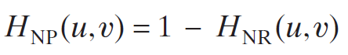
Notch Filter
Notch Pass filter:
It is note that it become lowpass filter if u₀=v₀=0.
np: north pass
nr: north reject

Slide 44

Notch Filter

Slide 45
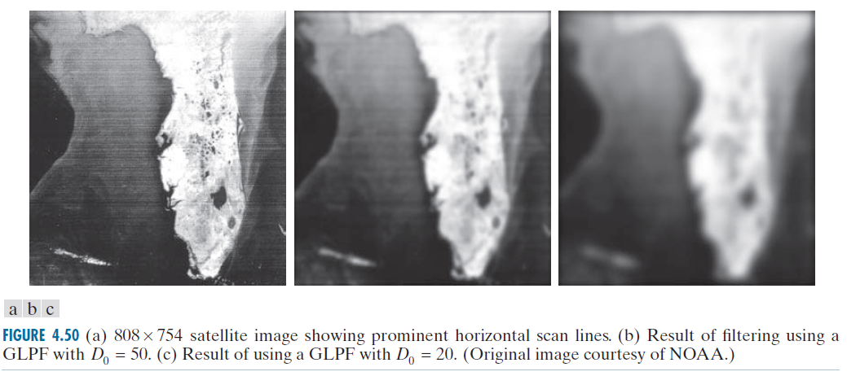
Notch Filter
Filtered by GLPF, example in Chapter 4

Slide 46
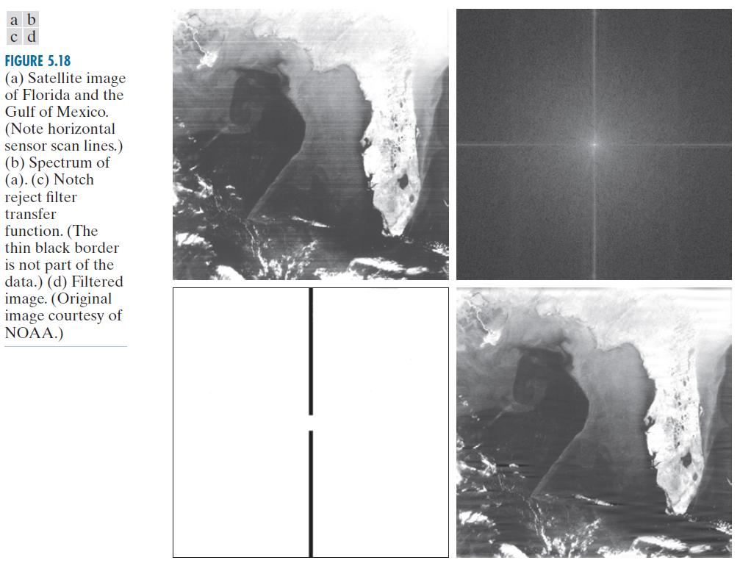
Notch Filter
Filtered by GLPF
Notch reject filter

Slide 47
Estimating the Degradation Function
Three principal ways to estimate
Observation
Experimentation
Mathematical modeling
Using a degradation function that has been estimated in some way to restore a image is called Blind deconvolution.
Because the true degradation function is seldom known completely.

Slide 48
Estimation by Image Observation
Given an image, without prior knowledge.
Gather information from the image itself.
Example: the image is blurred
Look at a small section of the image.
Look for areas of strong signal content.
Construct an unblurred image of the same size and characteristics as the observed subimage.

Slide 49
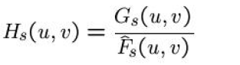
Estimation by Image Observation
Let the observed subimage be denoted by g_{s}(x,y).
Let the constructed subimage be denoted by Assuming the effect of noise is negligible (strong –signal area) , then
Deduce the complete function H (u, v).
Eg. Suppose that a radial plot of H_{s}(u, v) turns out to have the shape of Butterworth lowpass filter. We can use that information to construct a function H (u, v) on a larger scale, but having the same shape.

Slide 50
Estimation by Experimentation
Assume:
Equipment similar to another equipment
Obtain an accurate estimate of the degradation
Images similar to the degraded image
Various system setting
Until degraded as closely as possible to the image we wish to restore.
Space-invariant system with impulse response

Slide 51
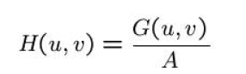
Estimation by Experimentation
Impulse response of the degradation
Imaging an impulse using the same system settings.
An impulse
Is simulated by a bright dot of light.
Bright enough to reduce the effect of noise.
Fourier transform of an impulse is a constant.

Slide 52
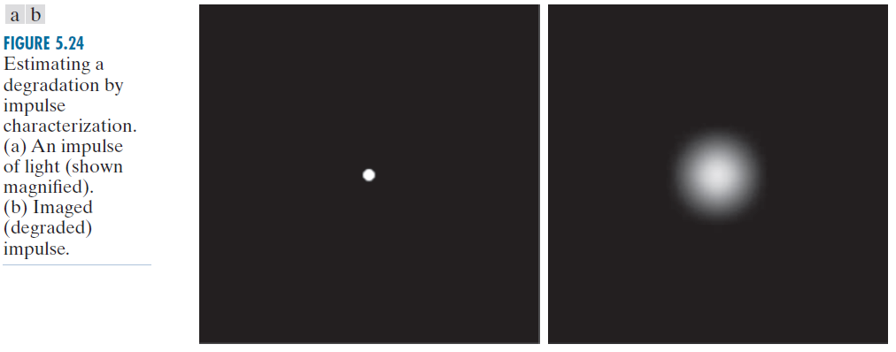

Estimation by Experimentation

Slide 53
Estimation by Modeling
Consider environmental conditions causing degradations
Example: atmospheric turbulence.
Hufnagel and Stanley 1964.
Modeling:
Where k is a constant, and depends on the nature of the turbulence.
Has the same form of Gaussian lowpass filter, it is used sometimes to model mild, uniform bluring.
Notes:
atmospheric
英 [ˌætməsˈferɪk] 美 [ˌætməsˈfɪrɪk]
adj. 大气（层）的，有关大气的；有神秘（美）感的，富有情调的
mild
英 [maɪld] 美 [maɪld]
adj. （伤病）不严重的，轻微的；（感觉或表情）不强烈的，微弱的；（惩罚或批评）不严厉的；轻的，不过度的；（味道）清淡的，不刺激的；（药物、化妆品等）柔和的，无副作用的；（肥皂、洗涤液）温和的，

Slide 54
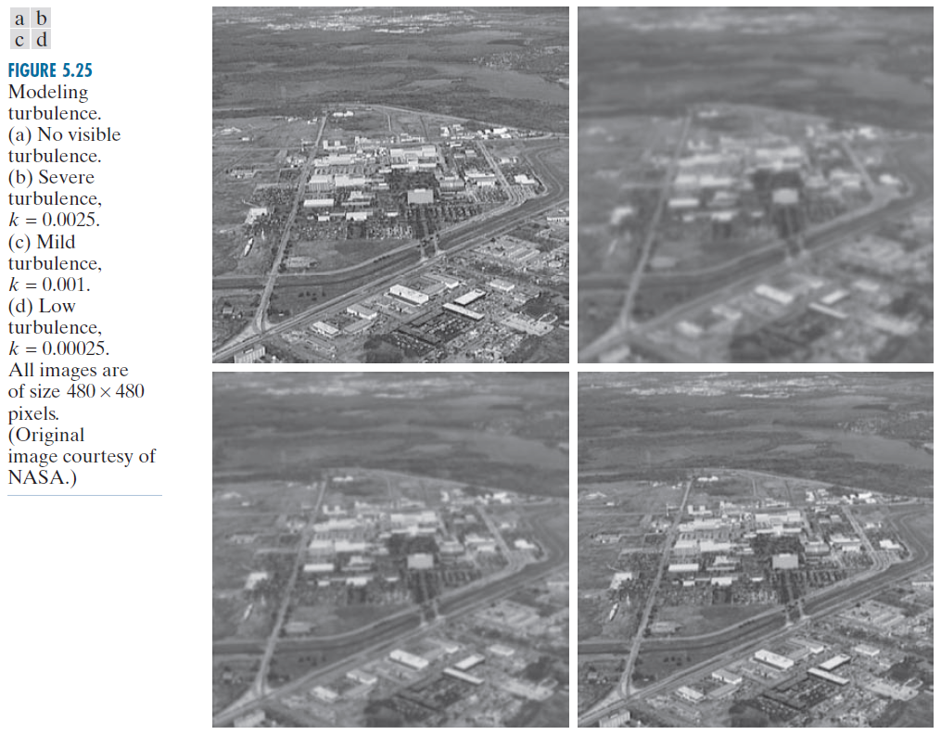
Atmospheric Turbulence
K=0.0025
K=0.001
K=0.00025

Slide 55
Estimation by Modeling
Derive a mathematical model of Motion Blur
An image blurred by uniform linear motion between Image and the sensor during image acquisition
Image f(x,y) is in planar motion
x₀(t) and y₀ (t) time varying components of motion

Slide 56
Motion Blur
Assuming shutter opening and closing takes place instantaneously, and optical imaging process is perfect, not affected by image motion. If T is the duration of the exposure, and g (x, y) is blurred image.
Section 4.6

Slide 57
Motion Blur

Slide 58
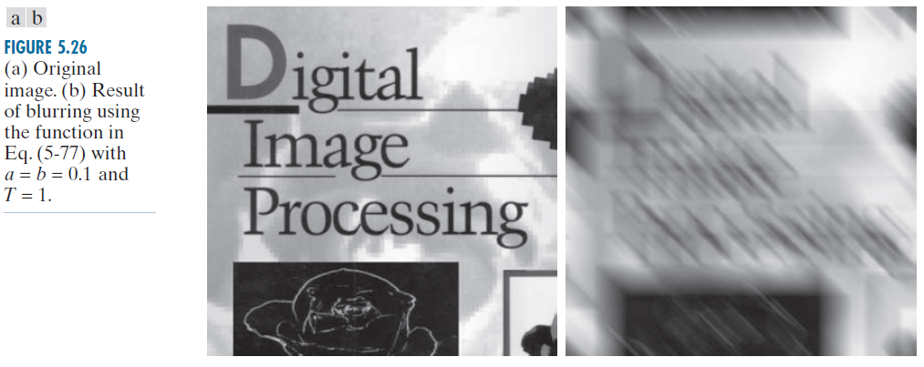
Motion Blur

Slide 59
Inverse Filtering
Studying restoration of images degraded by a degradation function H, which is given or obtained by a method, such as those discussed in the previous sections.
It tells us that even if we know the degradation function we cannot recover the undegraded image. Because N(u,v) is a random function whose Fourier transform is not known.

Slide 60
Inverse Filtering
Besides, if the degradation has zero or very small values, then the ratio N(u,v)/H(u,v) could easily dominate the estimate F(u,v). In fact, this is frequently the case.
Then how to deal with this situation?
Limit the filter frequencies to values near the origin.
H(0,0):
Is equal to the average value of h(x, y).
Highest value of H(u,v) in the frequency domain.
Reduce the probability of encountering zero values.

Slide 61
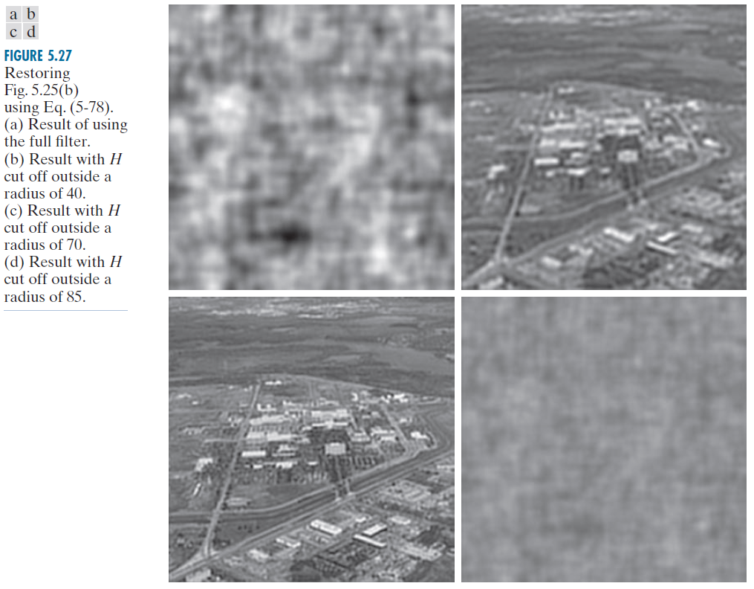
Inverse Filtering
Example: inversefilter.m
K=0.0025
原图

Slide 62
Wiener Filtering
Inverse filtering approach makes no explicit provision for handling noise.
Wiener filtering incorporate the information:
Degradation function
Statistical Characteristics of noise
Also called Minimum Mean Square Error Filtering.

Slide 63
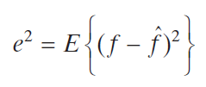
Wiener Filtering
Consider images and noise as random processes.
Objective is to find an estimate of the uncorrupted image f.
Mean square error between them is minimized:
􀂄 is the expected value of the argument.

Slide 64
Wiener Filtering
Assumption:
Noise and image are uncorrelated.
One or the other has zero mean.
The gray levels in the estimate are a linear function of the levels in the degradation image.

Slide 65
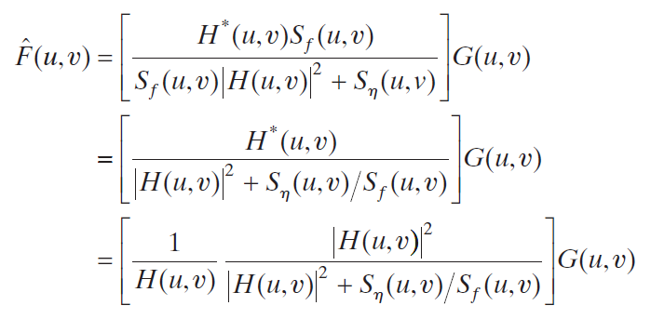
Wiener Filtering
The minimum of the error function in the frequency domain:
Wiener——1942

Slide 66
Wiener Filtering
Where:
H(u,v)=degradation function
H*(u,v)=complex conjugate of H(u,v)
|H(u,v)|²=H*(u,v)H(u,v)
S_{n}(u,v)=|N(u,v)|²=power spectrum of the noise
S_{f}(u,v)=|F(u,v)|²=power spectrum of the undegraded image
Note that if the noise is zero, then the noise power spectrum vanishes and the Wiener filter reduces to the inverse filter.

Slide 67
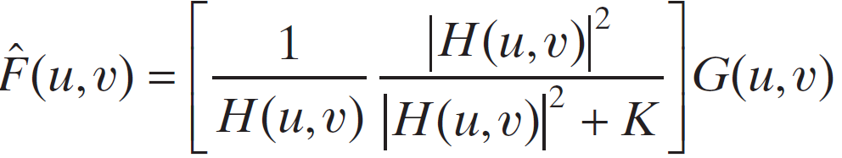
Wiener Filtering
Spectrally white noise, the spectrum |N(u,v)|² is a constant.
Power spectrum of the undegraded image seldom is known.
When these quantities are not known or cannot be estimated, we obtain approximation:

Slide 68
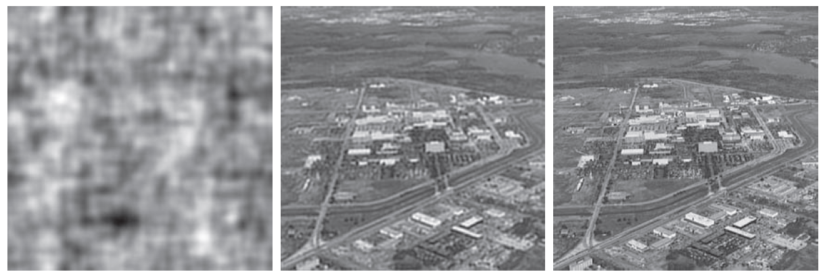
Wiener Filtering
逆滤波
半径受限逆滤波
维纳滤波
剧烈湍流K=0.0025
原图

Slide 69
Wiener Filtering

Slide 70
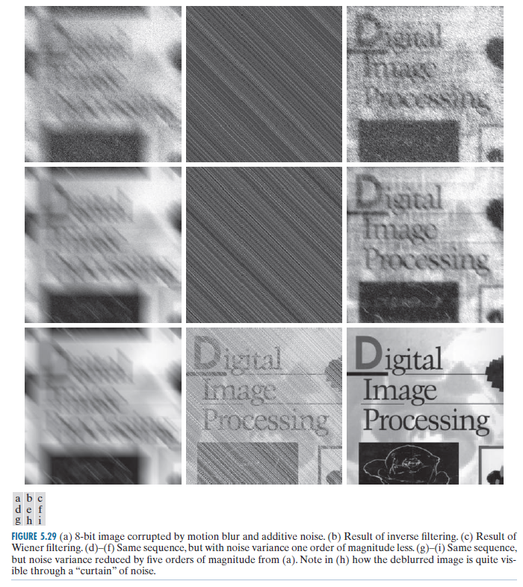
Wiener Filtering
Gaussian noise: mean=0, variance=650
Variance=65
Variance=0.0065
Example: wiener.m

Slide 71
Summary
In this lecture we looked at image restoration for noise removal
Restoration is slightly more objective than enhancement
Frequency domain techniques are particularly useful for removing periodic noise
Inverse filtering
Weiner Filtering

